Slide 1
UHIIS
Universal Health Identity Information System
Transforming Health Record Accessibility Globally
Presenter: Bernard Bazimya
In collaboration with
RN. Marley Hartman
Guided by Prof. Gurram Gopal

Slide 2
Main Problems
People lack access to their health records especially when relocating: Students, workers, and travelers cannot easily access and transfer their medical history across providers or borders.
Fragmented and Incompatible Health Systems: Scattered records across different systems, hospitals and clinics and places.
Delays and Inefficiencies in Healthcare Delivery: Lack of real time access leads to repeat tests, slower diagnosis, increased costs ..
Institutions struggle to manage health records and respond to emergencies in real time: Governments, universities, and employers,NGOs..

Slide 3
Our Solution - UHIIS
Universally Access to Health Records Anytime, Anywhere:
Individuals can securely access and share their complete medical history across states, countries, and healthcare systems, eliminating the risk of losing records when relocating.
Real-Time Interoperability Across Healthcare Providers:
UHIIS integrates with interoperability standards (e.g. HL7 FHIR) for data sharing across different systems.
Emergency-Ready Health Record Access:
Quickly access to critical patient information (e.g. pandemics, allergies, medications, chronic conditions)
Support for Institutions and Public Health to manage health records:
Universities, employers, governments and others can efficiently monitor health data in real time

Slide 4
Segments/Beachhead market/customer
Healthcare Providers:(Hospitals & Clinics) BH
Individual Users: (Students, Workers, Travelers)
Employers and Corporates (Companies)
Insurance Companies
Governments and Public Health Departments
International Organizations, Colleges and Universities
Total TAM across all evaluated markets segments to approximately $683.4 million annually

Slide 5
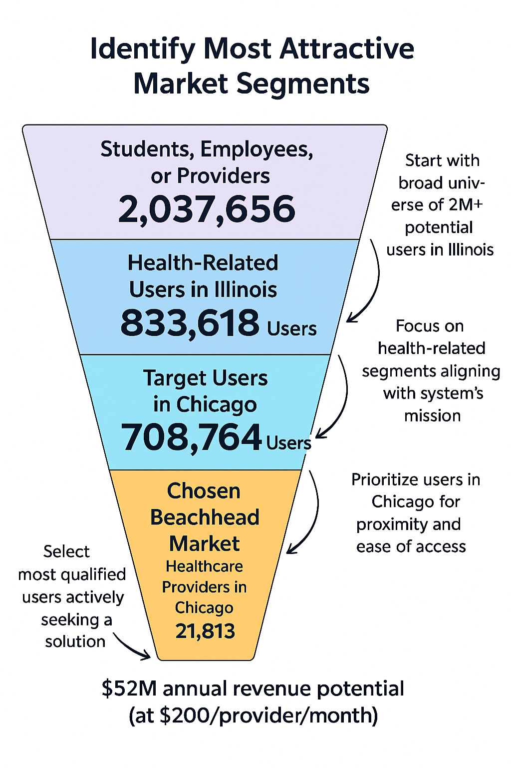
Market size (segment + TAM)

Slide 6
Business Model
Primary Revenue Streams
Healthcare Providers: Subscription Fees: $200/month per provider
Individual Users Subscription Fees: $2–5/month per individual (students, workers, travelers)
2. Secondary Revenue Streams (Expansion Options)
Insurance companies, large hospitals, and universities: Subscription Fees: $200/month
Governments public health entities: Subscription Fees: $200/month
Freemium Option (for The early bird catches the worm/for data aquisition )

Slide 7
Pricing
Based on our analysis, what is the price range of:
$24–$30/year for individual user
$150–$200/month for institutional
Competition and what are their prices:
Epic Systems, Cerner, SchoolDoc : average $390–$500/month/site.

Slide 8
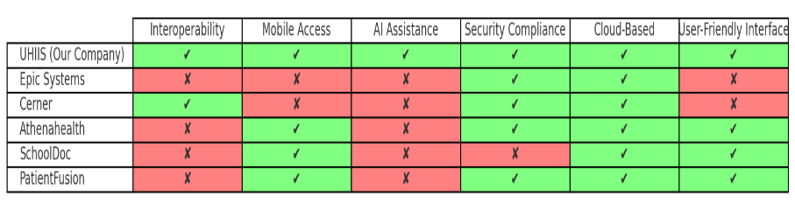
Competitive Moat / Differentiator
Comparison of our product features to others

Slide 9
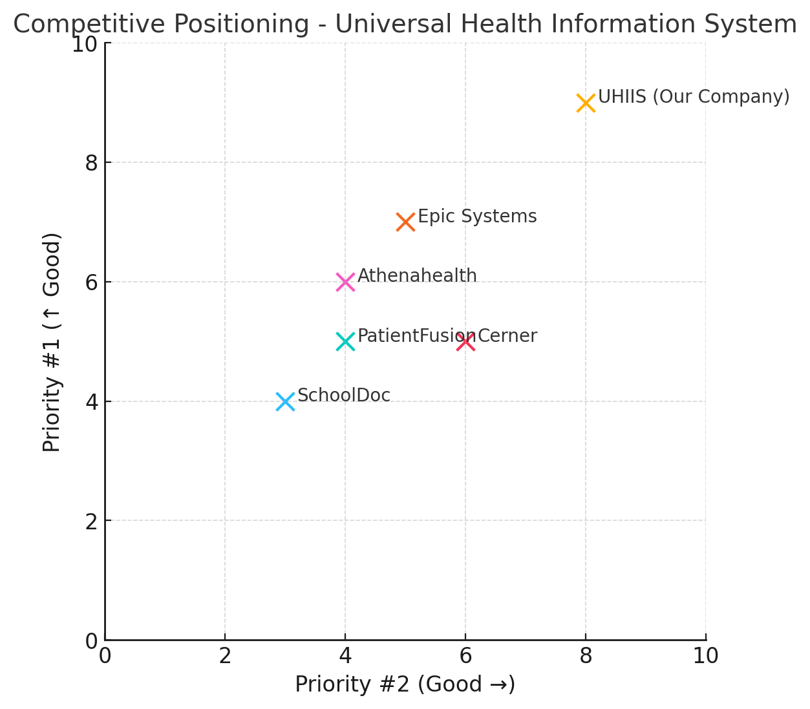
Competitive Moat / Differentiator

Slide 10
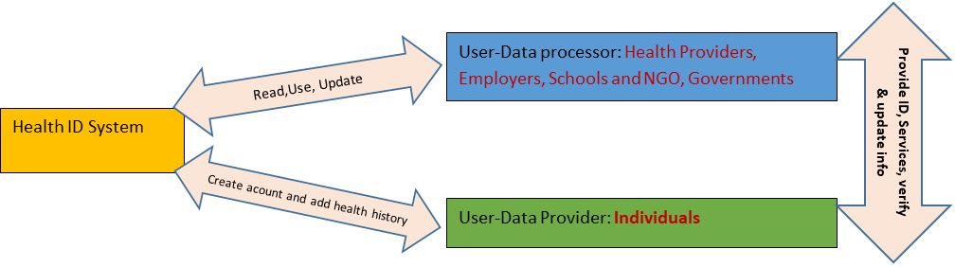
Product Design
Two sided Market
B2B
B2C

Slide 11
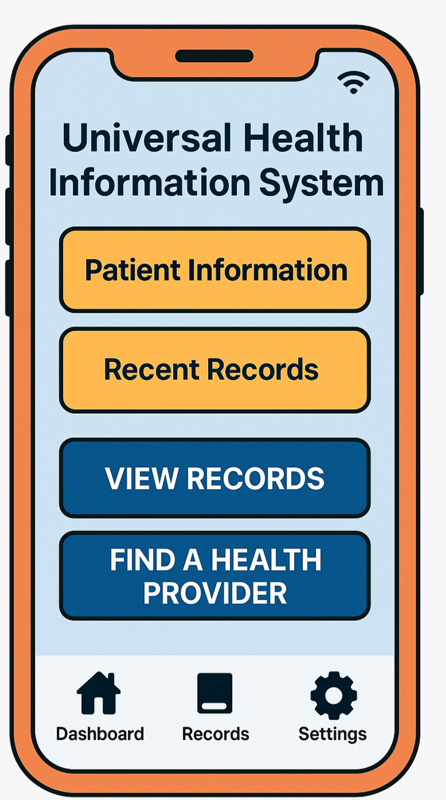
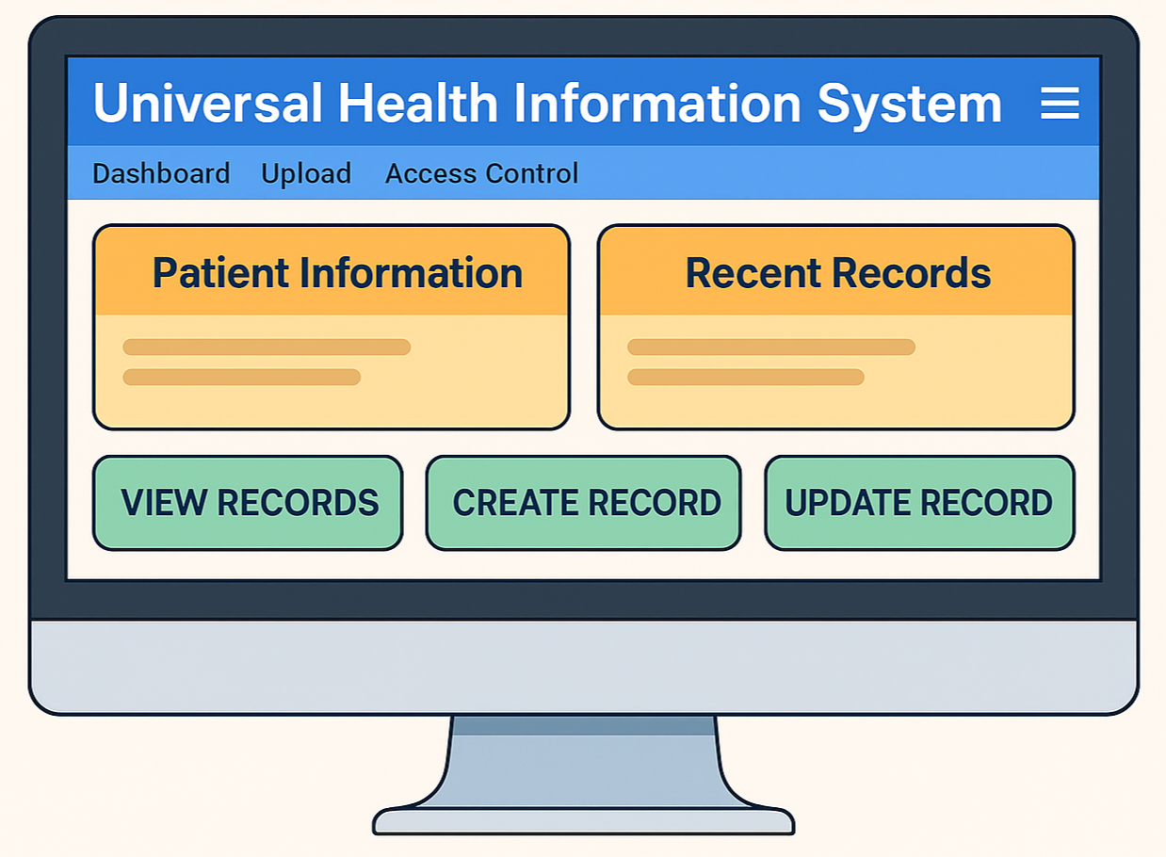
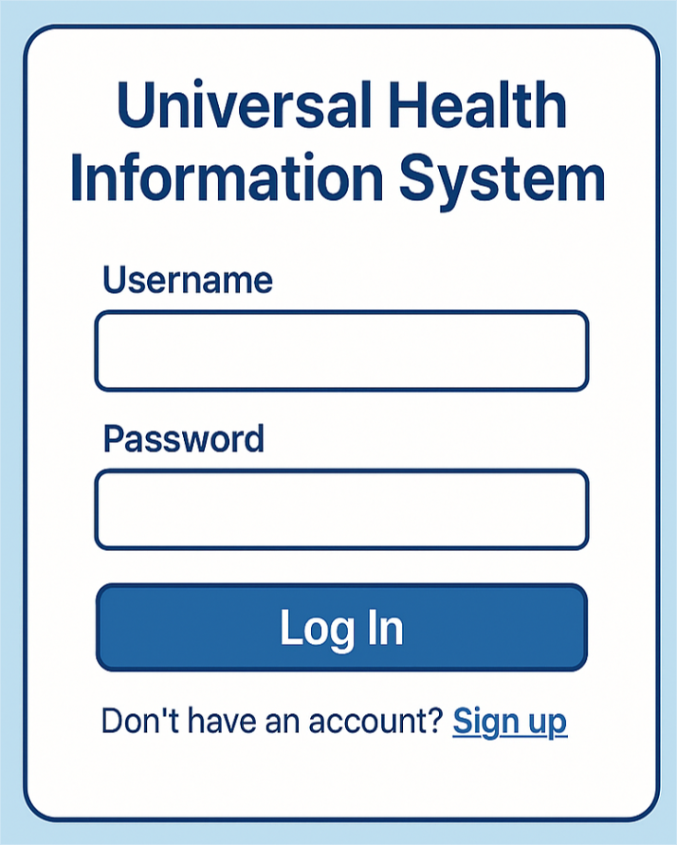
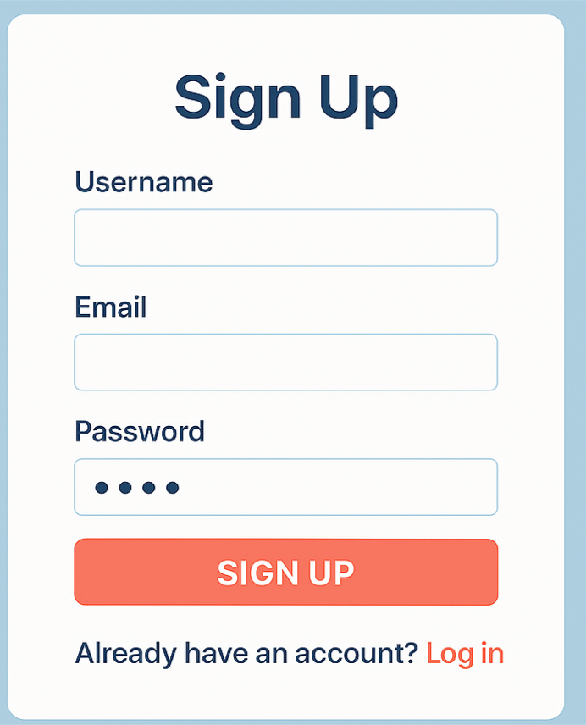
Product High Level Design

Slide 12
Funding
Target fund to be raised:
$500,000 USD (Initial Seed Funding)
Category | Description | Estimated Amount
UHIIS V1 Development | Build a secure, scalable (Web + Mobile Platform, Database, API) | $150,000
Security & Compliance Setup | HIPAA & GDPR compliance audits, security certifications | $50,000
Pilot Launch and Early Customer Acquisition | Onboard first 50 healthcare providers and some individuals (Chicago) | $100,000
Marketing & Branding | Website, professional branding, digital marketing, initial sales team | $75,000
Operations and Salaries | Small team (Engineers,marketing/sales, support) | $100,000
Legal and Administrative Costs | Incorporation, contracts, insurance, IP protection, initial taxes | $25,000
After successful pilot scaling/V1, ($2M–$5M) will be raised for V2

Slide 13
Board of Directors
Bernard Bazimya (CEO)
Chantal Elyse(CFO)
Taylor Washington(CMO)
Ashraf Abdul Muumin (CIO)
Name of Business: Universal Health ID

Slide 14
Closing Statement
"UHIIS: Empowering Health Access Everywhere.
Join us to revolutionize global healthcare access."

Slide 15
Q/A
Thank you!

